Slide 1

Practical Data Science with Python (COSC2670) - Assignment 3
S4068959
Jung-De Chiou

Slide 2
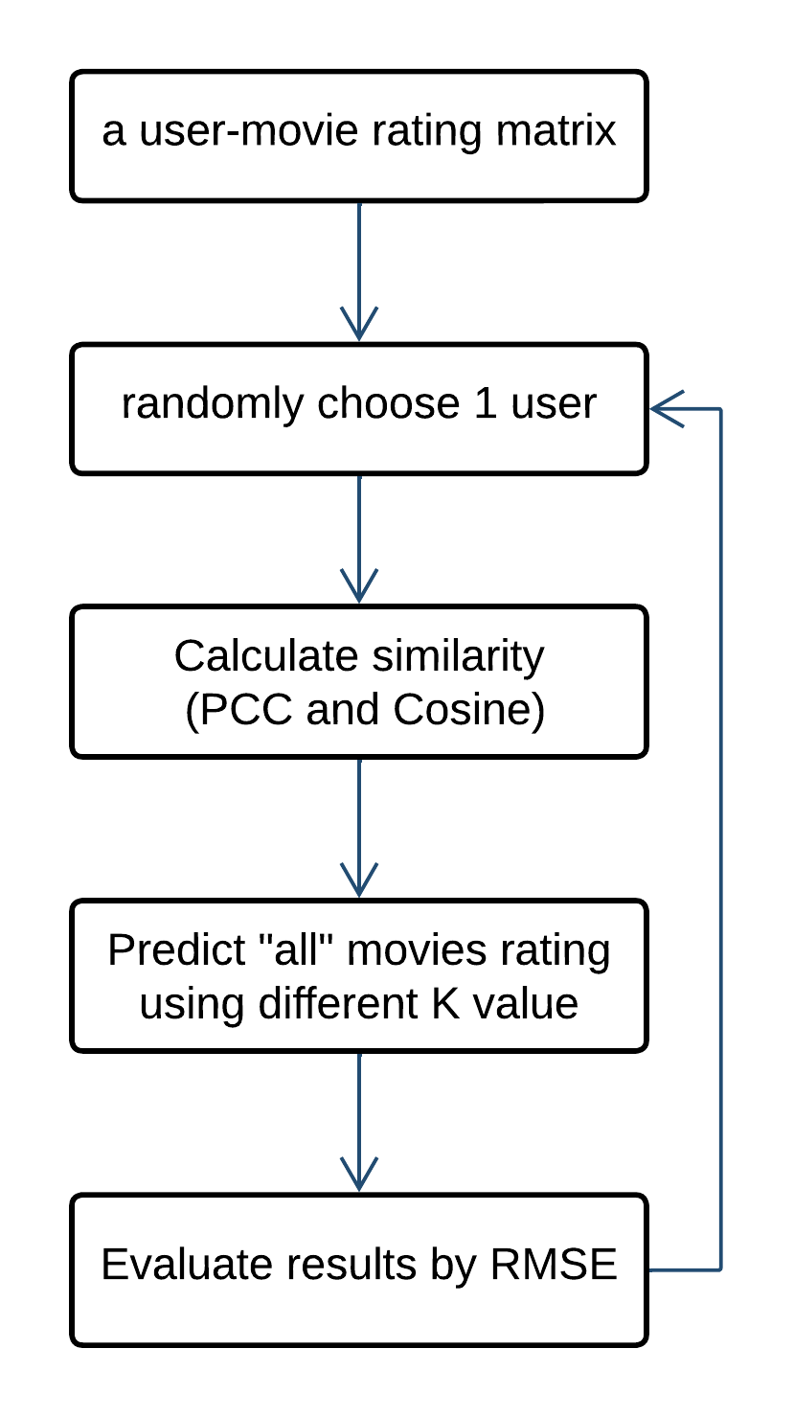
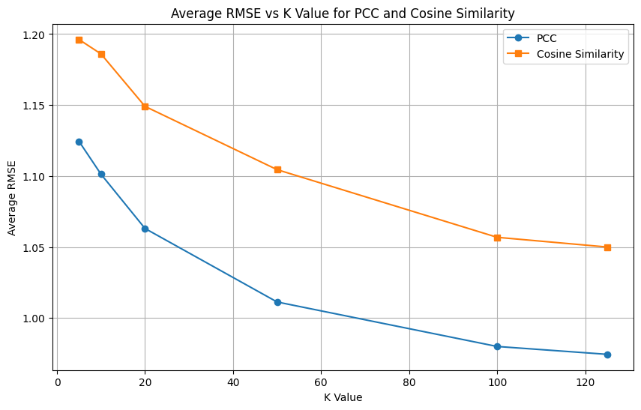
Task1: kNN-based Collaborative Filtering
Original Dataset:
6040 Users, 3883 Movies, 1000209 Ratings
PCC has better performance
K = 125 has lower RMSE
▶︎ Run 100 times and plot the average for each K value
※ Detailed calculation can be found in ipynb file
Notes:
First, we load the data. The original data is this amount of users, movies, and rating.
For task1, the step I did as below.
First, we use the loaded data to create a user-item rating matrix. Here the item is movie.
Then we randomly choose a user to push them recommendations.
So we calculated similarity for the user using PCC and cosine these two similarity metrics.
Then used kNN to predict all movie ratings for the user. I tested different values of K to compare the performance, like 5 10 20 50 100 125.
Finally, calculate the RMSE result. And do this whole process again and again for 100 times, then took the average plot the graph on the right hand side.
It’s apparently PCC has better performance than Cosine similarity. And the best K value will be 125. It performed the lowest RSME.

Slide 3
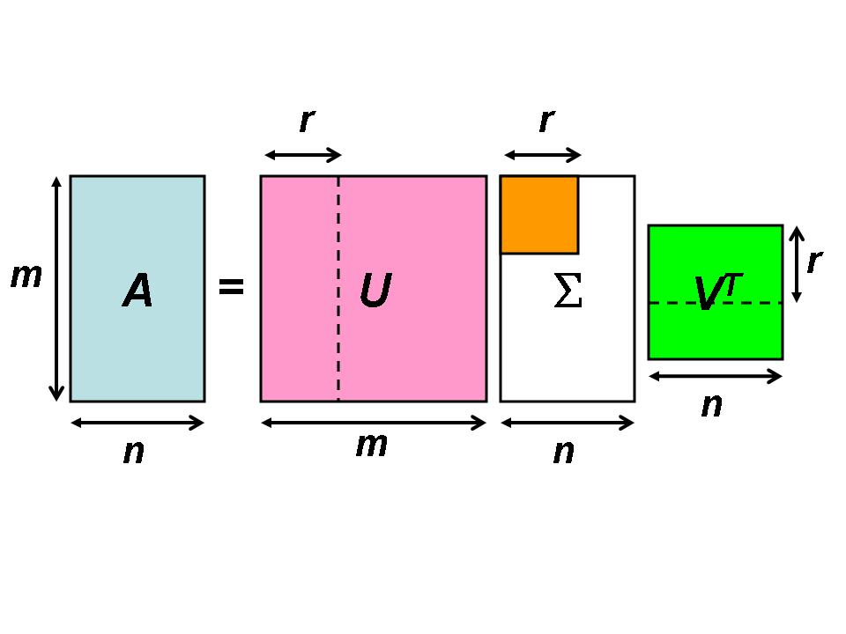
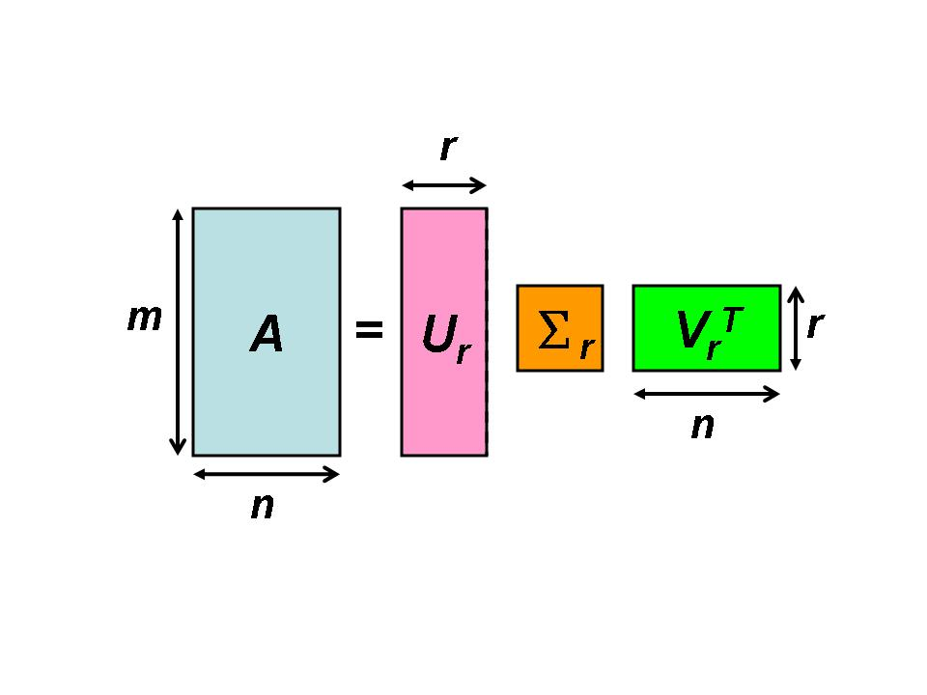
Task2: Matrix Factorization-based Recommendation
SVD（Singular Value Decomposition）:
Singular Value Decomposition (SVD) is a mathematical technique used in linear algebra to decompose a matrix into three other matrices. Specifically, it factorizes a given matrix A into three matrices: U, Σ, and V^{T}
U = It represents the relationships between the rows (e.g., users).
V^{T} = It represents the relationships between the columns (e.g., items).
Σ = These values help identify the dominant latent features in the data.
Truncated SVD:
Truncated SVD is a variant of SVD that is used specifically to reduce the dimensionality of the data by keeping only the most significant components. Instead of decomposing a matrix completely into UΣVT, Truncated SVD only retains the top k singular values and their corresponding vectors. This is particularly useful in handling large, sparse matrices, which are common in applications like natural language processing and recommendation systems.
Phadnis, Neelam & Gadge, Jayant. (2014). Framework for Document Retrieval using Latent Semantic Indexing. International Journal of Computer Applications. 94. 37-41. 10.5120/16414-6065.
Notes:
For task2 I used SVD, singular value decomposition to do this part.
Basically, SVD is a technique to decompose the matrix into three other matrices
Simply put it,
U represents the relationships between the rows (e.g., users).
V^{T (}V transpose) represents the relationships between the columns (e.g., items).
The values in sigma help identify the dominant latent features in the data.
But in my code, I used the TruncatedSVD by Sklearn library to reduce the effect of large, sparse data and enhance the calculating speed.

Slide 4
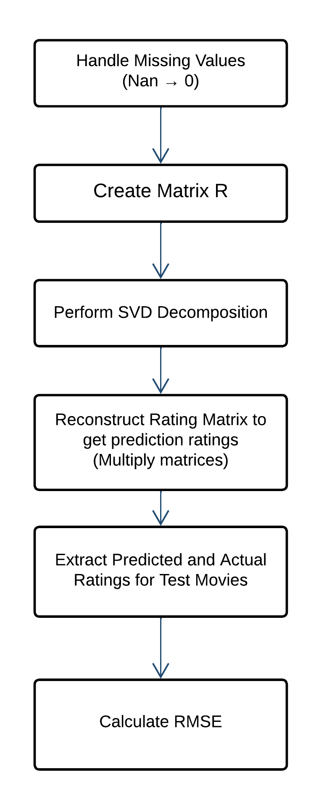
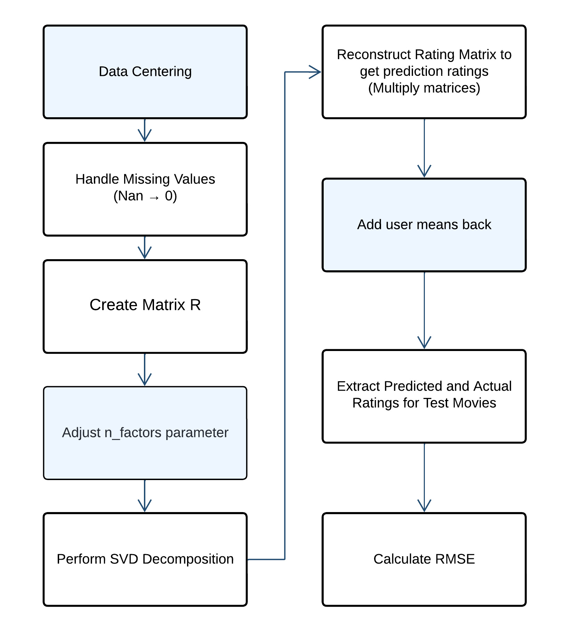
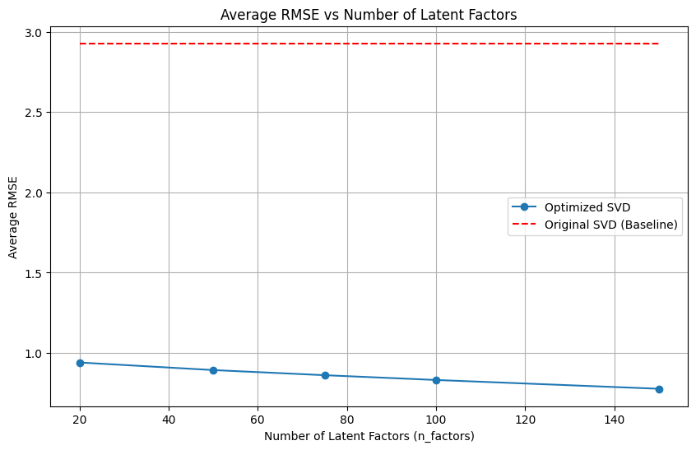
Task2
▶︎ Randomly choose 5 items and predict all users' ratings on these movies.
Truncated SVD
Modified Truncated SVD
Data centering and Adjusting n_factors parameters
Modified SVD performance better than the original one
N_factors = 150 has lower RSME
Restrict n_factors to 150
▶︎ Run 100 times and plot the average for each n_factors value
Notes:
For implementation, Here is the original steps I did for Truncated SVD. And for the improved one, I first did the data centering to reduce the users rating bias. Then adjust the n_factors parameter
The higher the value of `n_factors`, the more details the SVD can capture when decomposing, which allowing the model to predict more complex preference patterns. However, when `n_factors` is too high, it may lead to overfitting. Therefore, I have limited the maximum value of `n_factors` to 150, to achieve a balance between training performance and generalization capability.
I also ran this process for a 100 times and calculated the average to plot the graph. We can observe that when n_factors equals to 150, the modified one has better RMSE.

Slide 5
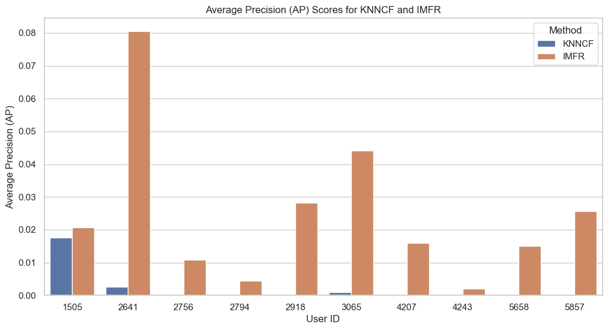
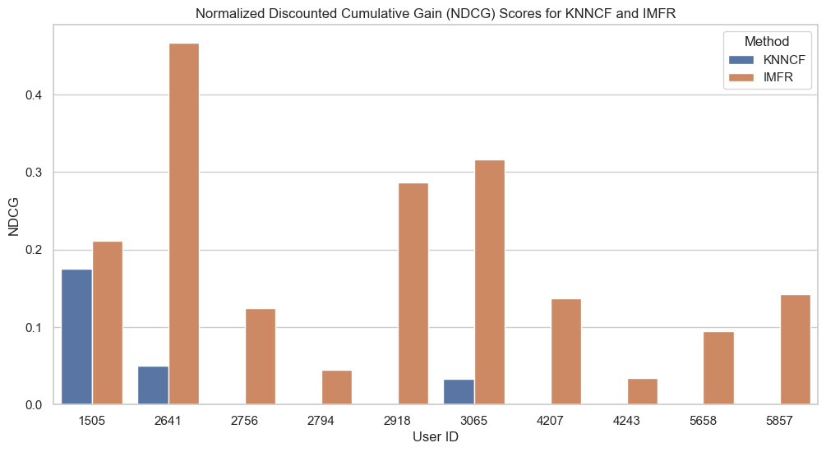
Task3: Ranking-based Evaluation and Comparison
Randomly choose 10 users and recommend Top-20 movies to each of them
AP (Average Precision)
NDCG (Normalized Discounted Cumulative Gain)
IMFR consistently outperforms KNNCF
KNNCF's performance is significantly lower, with many instances where the AP and NDCG scores are close to zero.
Notes:
Proceed to task3. we randomly choose 10 users and recommed top 20 movies to each of them. Using Average Precision and Normalized Discounted Cumulative Gain to evaluate the performance for KNNCF and IMFR.
After evaluating both KNNCF and IMFR methods using AP and NDCG metrics, we observed the following:
IMFR consistently outperforms KNNCF across all users in both AP and NDCG scores.
KNNCF's performance is significantly lower, with many instances where the AP and NDCG scores are close to zero.
IMFR shows higher AP and NDCG scores, indicating that it ranks relevant items higher in the recommendation list.

Slide 6
Task3
Limitations of KNNCF
Data Sparsity Issues:
KNNCF relies on finding users with similar tastes based on co-rated items. With few overlapping ratings, it's challenging to compute reliable similarities.
Ineffective Similarity Measures:
The Pearson correlation coefficient may not be effective when the number of co-rated items is small. Also, Ratings can be influenced by outliers or users with unusual rating behaviors, affecting similarity calculations.
Why IMFR Delivers Better Performance
Capturing Underlying Preferences: IMFR uses Singular Value Decomposition (SVD) to uncover latent factors that represent hidden patterns in user preferences and item characteristics.
Reduced Dependence on Co-Rated Items: IMFR does not rely solely on direct co-rated items between users, making it more robust in sparse datasets.
Better Generalization: By reducing dimensionality, IMFR can generalize from observed ratings to predict unseen ratings more effectively.
Data Compression: SVD compresses the user-item matrix, mitigating the impact of missing values.
How to Improve
Include Side Information: Use user demographics, movie genres, and other metadata to enhance the recommendation process.
Address Data Sparsity: Implement techniques like data imputation or clustering to reduce sparsity.
Significance Weighting: Adjusting significance weighting (GAMMA parameter) to mitigate the effect of users with few co-rated items.
Notes:
There’re few reasons may cause these huge performance difference
First the limitation of KNN collaborative filtering cannot really handle too sparse large data due to its reliance on co-rated items. Also the similarity measures I used is Pearson, which may not be effective when the number of co-rated items is small.
The possible way to improve it. One is including more side information for the user, to robust the similarity calculation. Second is using like clustering or other techniques to reduce the sparsity. Third, adjust the siginificance weighting parameter GAMMA to mitigate the effect of users with only few co-rated items.
And the reason IMFR has better performance is because SVD can capture users preference or items characteristics. Therefore, it does not solely rely on co-rated items. It can better deal with the sparse datasets.
Also, by reducing dimensionality, IMFR has better generalization capability and ability to mitigating the impact of large missing values.

Slide 7
Reference
scikit-learn. (n.d.). sklearn.decomposition.TruncatedSVD. Retrieved from https://scikit-learn.org/dev/modules/generated/sklearn.decomposition.TruncatedSVD.html
Data Aspirant. (n.d.). Truncated SVD. Retrieved from https://dataaspirant.com/truncated-svd/
V7 Labs. (n.d.). Mean Average Precision. Retrieved from https://www.v7labs.com/blog/mean-average-precision
Towards Data Science. (2022, October 15). What is Average Precision in Object Detection & Localization Algorithms and How to Calculate It. Retrieved from https://towardsdatascience.com/what-is-average-precision-in-object-detection-localization-algorithms-and-how-to-calculate-it-3f330efe697b
Evidently AI. (n.d.). NDCG Metric. Retrieved from https://www.evidentlyai.com/ranking-metrics/ndcg-metric

